Slide 1
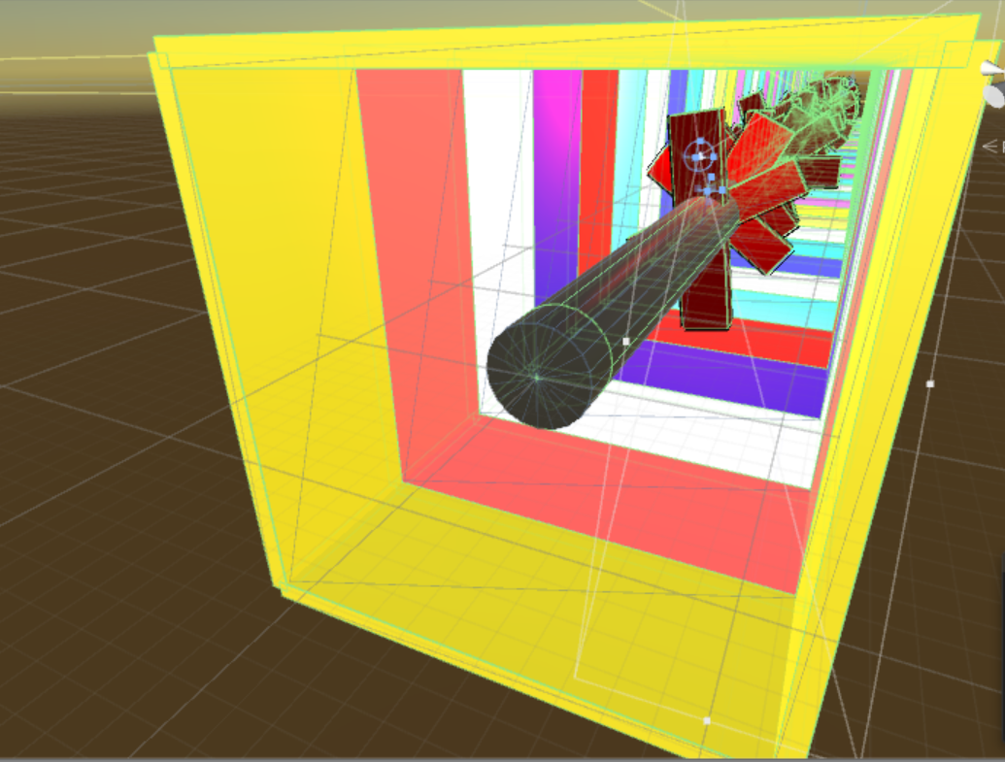
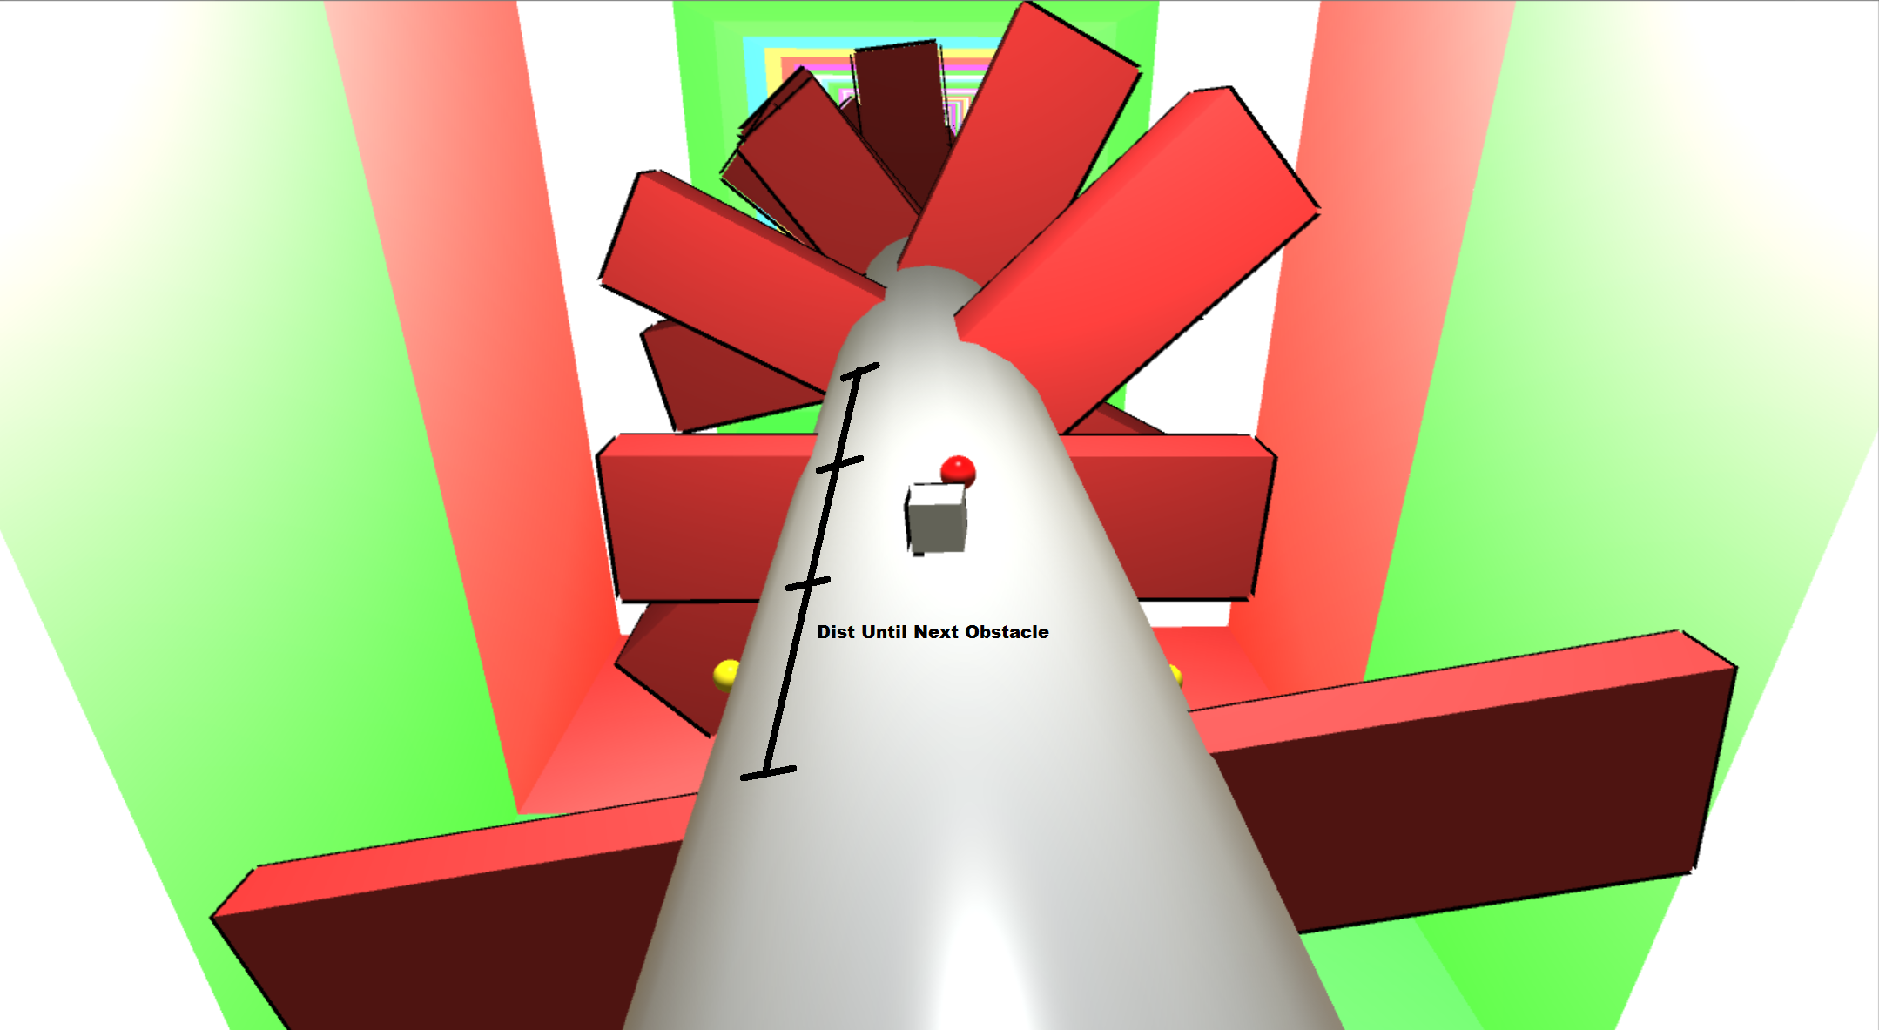
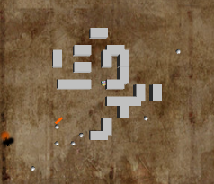
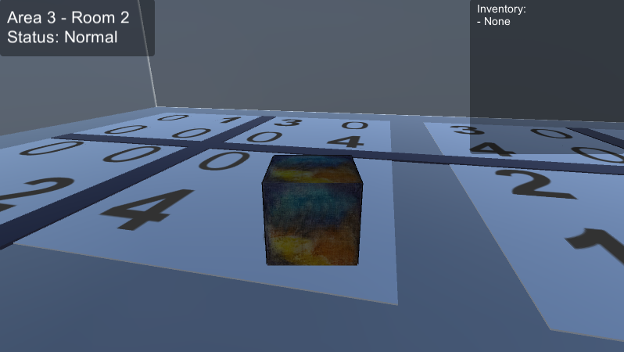
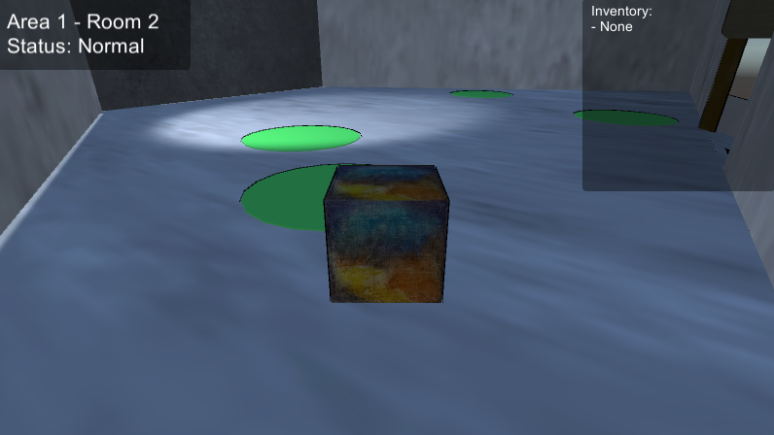
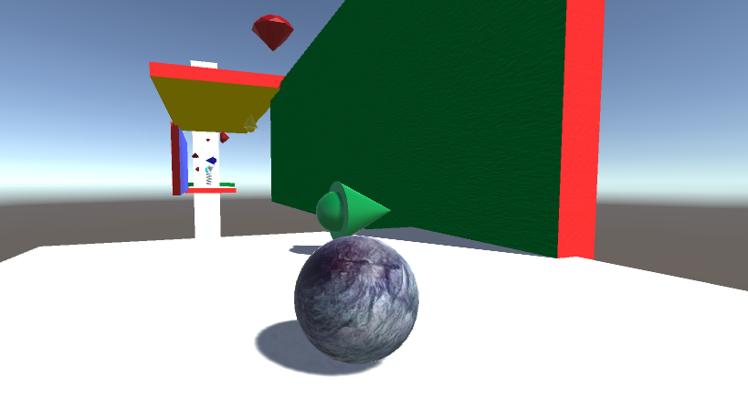
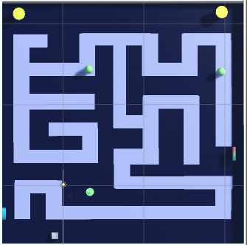
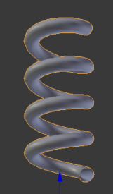
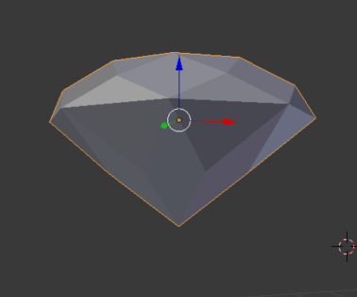
Legend of Cubie
Team Geotronics
Technical Implementations
Racetrack
Racetrack cylinder is generated in sections with neighboring walls , obstacles, and powerups
As Cubie progresses, the racetrack increases in difficulty: speed increases, obstacles are more frequent and challenging
Difficulty is calculated as a function of distance player has traveled, which tweaks generation parameters
Cubie is stuck to the track by a force proportional to his distance away from the track edge. He dodges by rotating the track beneath him and is constantly propelled forward.
Every racetrack section incorporates randomness into its generation: game improves replayability
Game maintains efficiency at run-time by removing procedurally generated content after the player has passed through them
Random-based Maze Generation
Interactivity
Maze grids are randomly generated based on: number of columns and rows, wall spawn and rotation likelihood, enemy spawn likelihood and enemy level likelihood
Wall sizes and positions are calculated at run-time in order to create unique and solvable mazes on each level load within the maze grid
Frequent use of trigger colliders to detect movement and input to solve puzzles
Audio to play on completion of set tasks, and user-interface assistance
Detect location, inventory, health
Directional Gravity Platforming
State-dependent physics and controller
State-dependent environment and player attributes
Custom models and textures
Search-based Maze Generation
Mazes were generated using search-based procedural content generation and modified so that puzzle elements can be embedded
Search space: 20,250,000 8x8 perfect mazes generated by randomized backtracking algorithm
Desired properties:
intermediate amount of branches (40%) on a maze
Average size of dead-end is a little small (30%) on a maze
Solution path has a midium turns (40%) on a maze
Double Jump Model
Gem Model

